Slide 1




CSCI 1070 final project
By : Mahley Getu

Slide 2
What are we predicting ?
Null hypothesis : The release date , genre and available country of film/tv series does not significantly affect the probability of the movie/tv series having a good rating
Alternative hypothesis : The release date , genre and available country of film/tv series does significantly affect the probability of the movie/tv series having a good rating
How can we prove this ?

Slide 3
We can prove this by…
Implementing both multiple linear regression and random forest regression provides complementary insights into the relationships between the features and the target variable. Multiple linear regression is valuable because it establishes a clear mathematical relationship, offering an interpretable equation that quantifies how each feature linearly affects the target variable. This is particularly useful for understanding straightforward, proportional dependencies and identifying whether each feature has a statistically significant impact. However, it assumes linearity and may underperform if the relationships are complex or involve interactions between variables.
On the other hand, random forest regression is a non-linear, ensemble-based approach that can handle complex patterns and interactions between features. It does not require strict assumptions about the data, such as linearity or normality, making it more flexible and robust in capturing real-world relationships. Additionally, random forest provides feature importance scores, helping to identify which variables have the greatest influence on the target. By implementing both models, we can compare their results, balance interpretability with predictive power, and gain a deeper understanding of the data, ensuring robust and well-rounded insights.

Slide 4
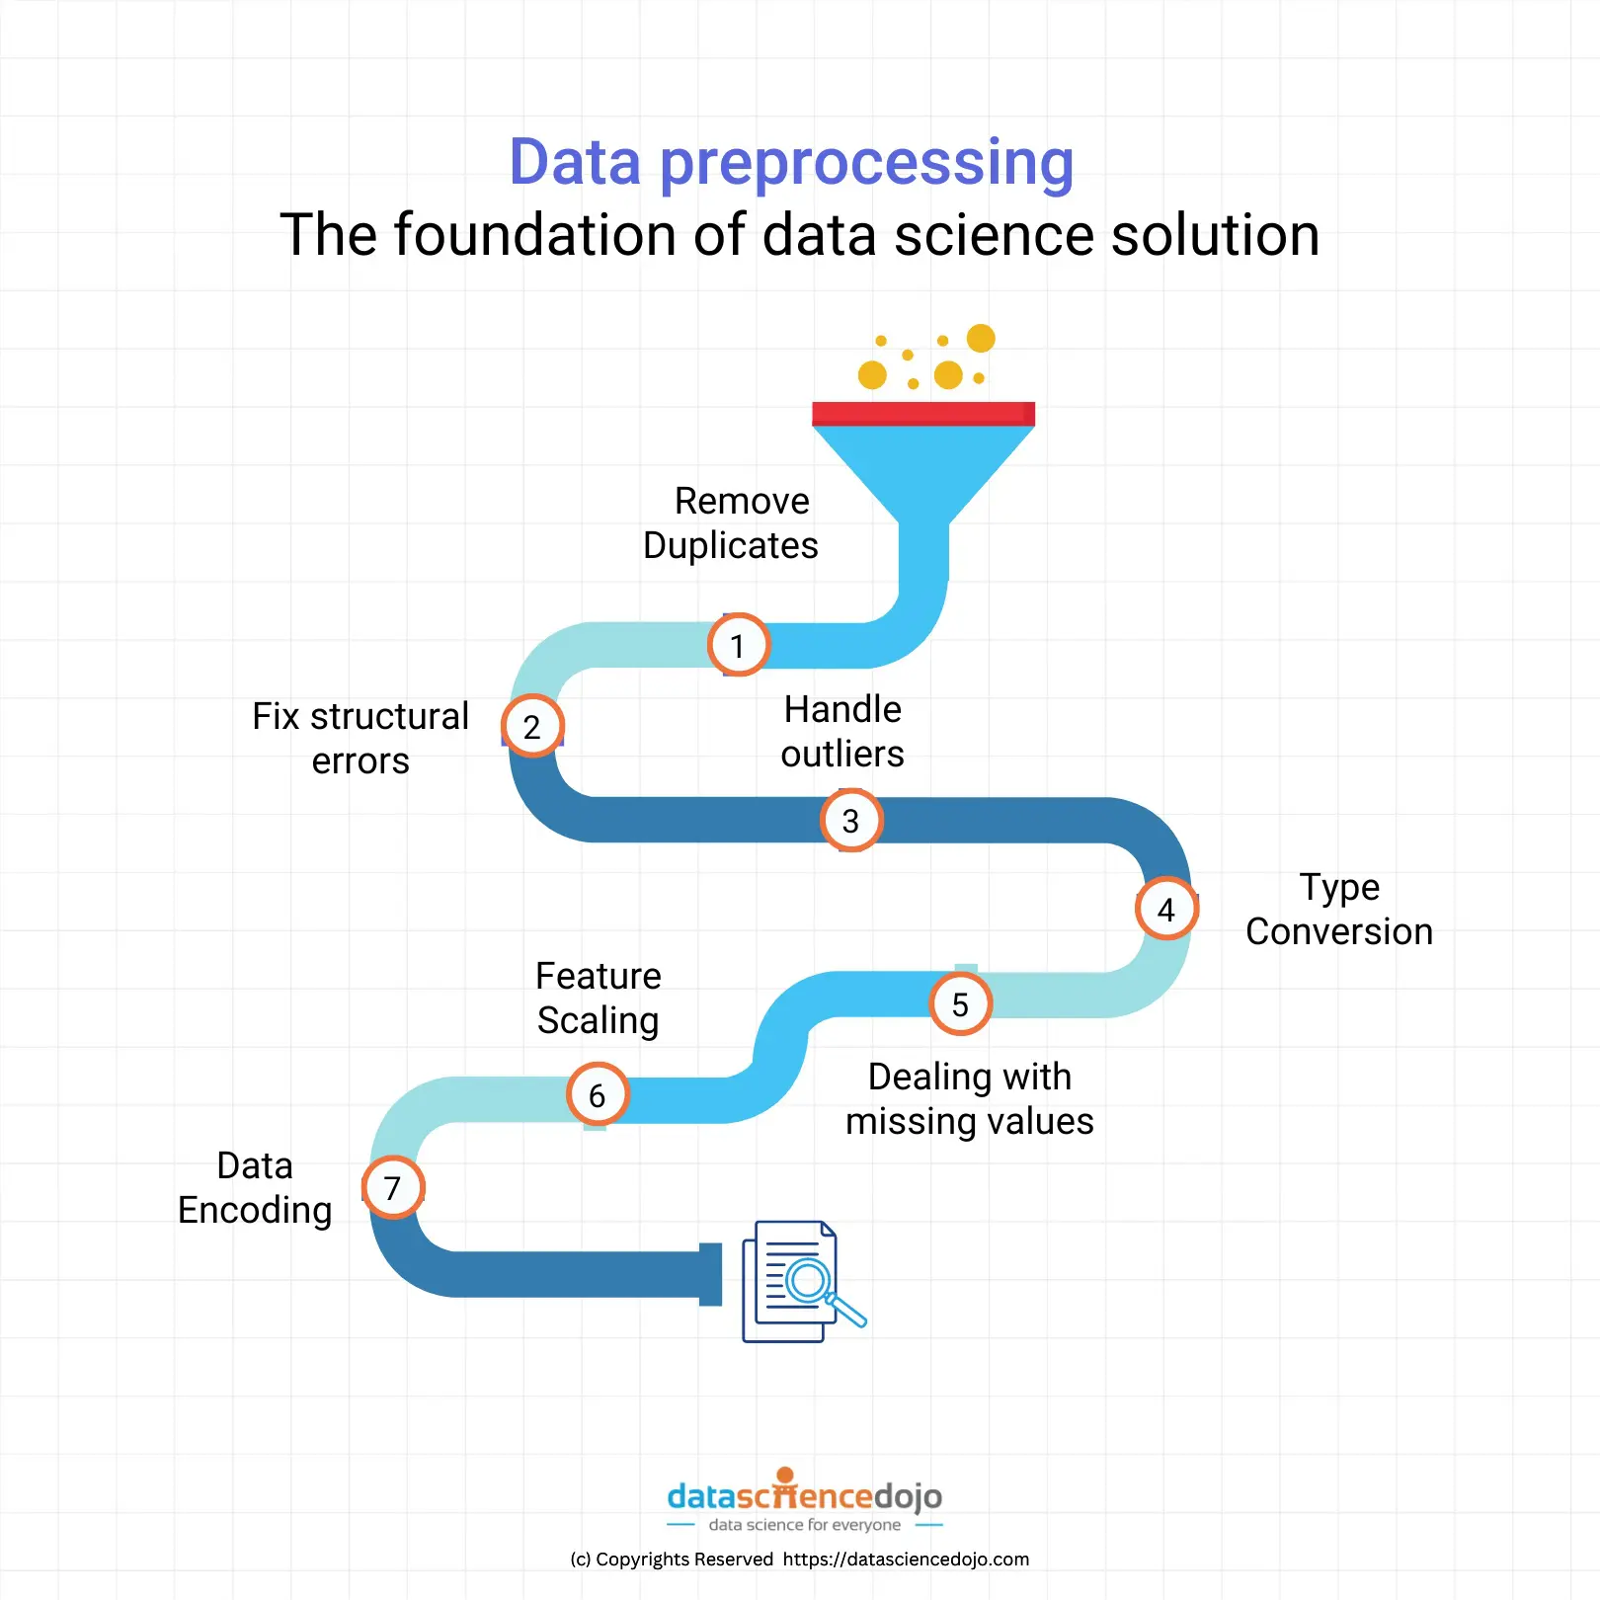
Preparing the data for said machine learning models
Data preparation is the first step in the process, which involves either deleting or imputing missing values. Techniques like one-hot or label encoding are used to encode categorical data, such as genre and available country, into numerical representations. In order to guarantee compatibility with models that are sensitive to feature magnitudes, numerical features like the release date might need to be scaled. To assess model performance, the data is first prepared and then divided into training and testing sets.

Slide 5
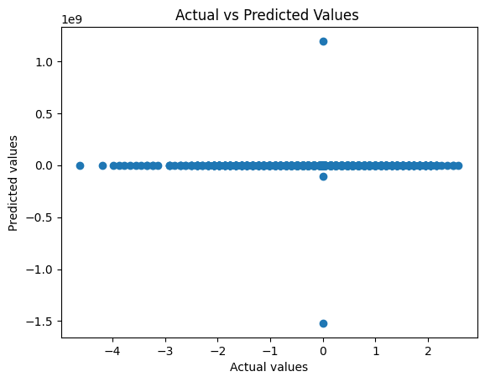
Multiple Linear regression -
This plot agrees with my hypothesis because it shows that my model’s predicted values don’t change meaningfully in relation to the actual values. Instead of forming a diagonal line where predictions closely match actual values, the points are mostly flat or scattered. This tells me that the model isn’t capturing any strong relationship between the features I used—like genre, release year, and country availability—and the ratings. It supports my belief that these features don’t have a significant correlation with the ratings, just as my hypothesis suggests. The lack of a clear pattern, with most points being spread out, suggests that these features don’t have a strong relationship with the ratings. This is exactly what I expected, as I hypothesized that these features wouldn’t have a significant impact on the ratings. If they did, we would have seen the points closer to the diagonal line.
This scatter of points also suggests that there might be other factors affecting the ratings that I didn’t include in the model. These missing factors could be influencing the ratings more than the ones I chose, like perhaps audience preferences, critical reviews, or other aspects of the movie industry. So, this plot reinforces the idea that the features I selected don’t explain much of the variation in the ratings, supporting my hypothesis.

Slide 6
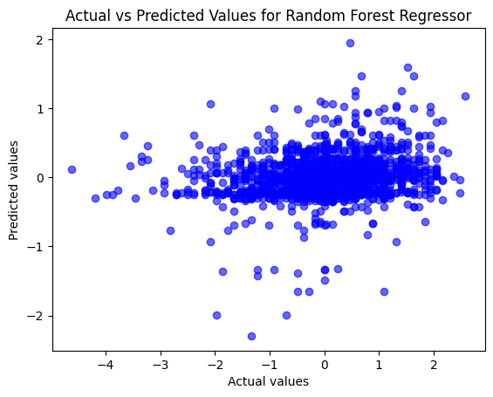
Random Forest regressor-
The plot agrees with my hypothesis because the points are widely scattered around the diagonal line instead of clustering closely along it. This tells me that the model isn’t consistently accurate in predicting the ratings, which suggests that the features I used, like genre, release year, and country availability, don’t have a strong relationship with the ratings. It supports my belief that these features don’t significantly correlate with the target variable, just as my hypothesis states.

Slide 7
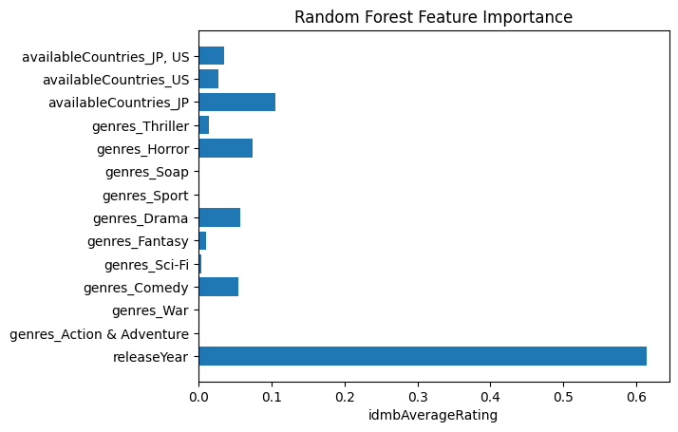
Feature Importance
This figure depicts the feature importance of a Random Forest model. The y-axis lists the features, while the x-axis shows their important values.
The most essential characteristic is "release Year", which indicates that the year a movie was released is a critical aspect for the model. The next two most essential features are "genres_Action & Adventure" and "genres_War".
The factor with the lowest importance is "availableCountries_JP, US", indicating that the availability of a movie in Japan and the United States is less essential for the model's predictions than the other features.
Overall, this graphic shows the elements the Random Forest model prioritizes when making predictions. It can provide guidance for future feature engineering and model development efforts.

Slide 8
Conclusion
After reviewing all of the stories, I concluded that the features I employed, such as genre, release year, and nation availability, do not have a substantial link with movie ratings. The scatterplots demonstrate that my model fails to produce accurate predictions, and the heatmap indicates that these features have weak or no meaningful associations with the target variable. These findings corroborate my hypothesis that these qualities have no substantial influence on ratings, implying that other factors may play a larger role in determining how movies are assessed.These findings support my hypothesis that these specific traits do not correlate with movie ratings, at least not in ways that the Random Forest model can easily capture. This implies that other factors, such as user preferences, movie popularity, or other unknown variables, may have a greater influence on ratings. Moving forward, I may consider adding more features or tweaking the model to gain a better understanding of what really drives ratings.

Slide 9
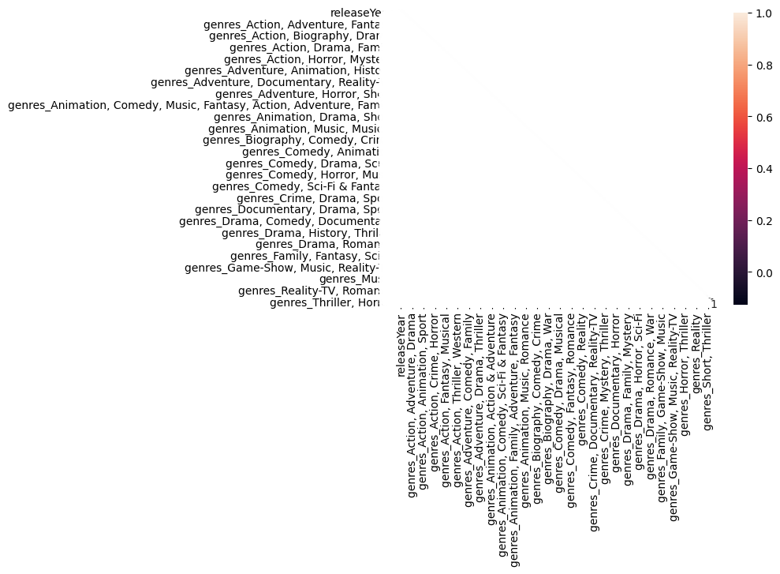
Heatmap-
A heat map is a data visualization method that makes it simple to see trends, connections, and outliers in the data by representing numbers with a grid of colors. Every cell in the grid represents a pair of variables, and the gradient or color intensity represents the strength or magnitude of a certain statistic, like frequency or correlation. The heatmap illustrates how various factors in my dataset, such as genres and release year, connect to the target variable (movie ratings). The color scale on the right represents the strength of these relationships, with lighter colors representing stronger positive correlations and darker hues indicating weaker or no link. From what I can tell, the majority of the values are near to 0 or very low, indicating that there is little to no link between the attributes and the ratings.

